Slide 1

Senior Design Project: SodaShop
Justin Kleen, Austin Koenigs, Paul Litherland, Liam O’Malley, & Nic Witulski
12/6/24
University of Nebraska – Lincoln
Department of Electrical and Computer Engineering

Slide 2
Overview
An Outline of the Project
Background
Specifications
Explanation
Results
Conclusion
References

Slide 3

Background & Problem to be Solved
Cans of soda and other soda mixing machines do not allow for customer customization and control.
SodaShop allows for the ultimate customizability and control of soft drink creation bolstered by seamless automation.

Slide 4
Specifications
24 V operating voltage
6A rated current draw
4 peristaltic pumps
1 air pump
Rasberry pi 4B
Custom pcb with rp2040
2 relay boards with 4 relays each
7in touchscreen interface

Slide 5
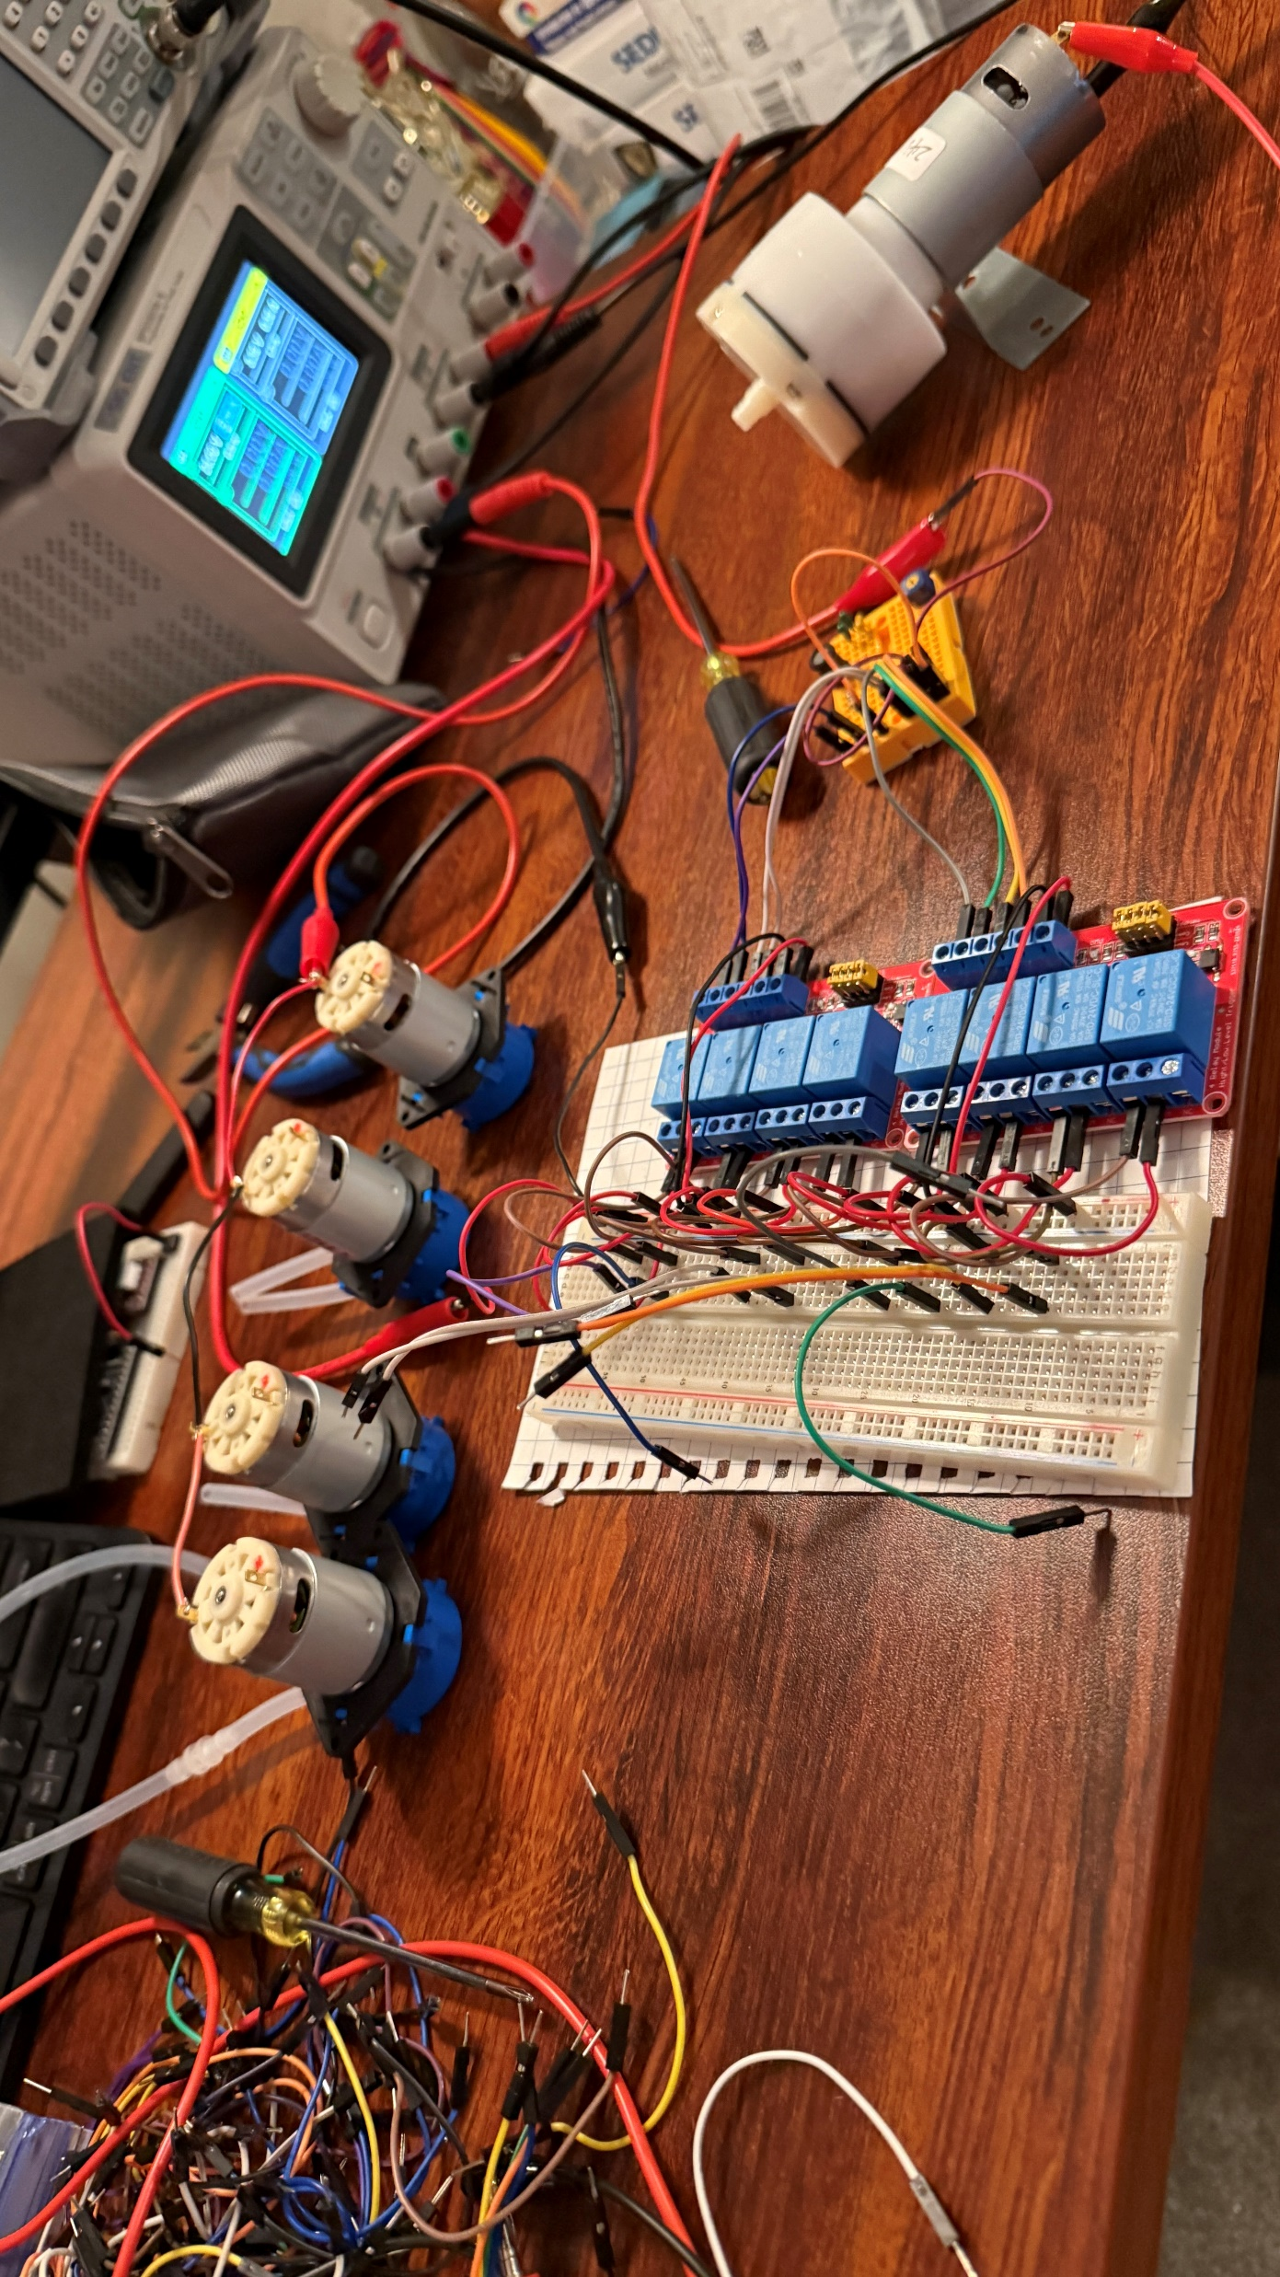
Explanation
UI Library:
GUIZero
Relays:
Will be controlled by custom pcb receiving signals from raspberry pi interface
Food Safety

Slide 6
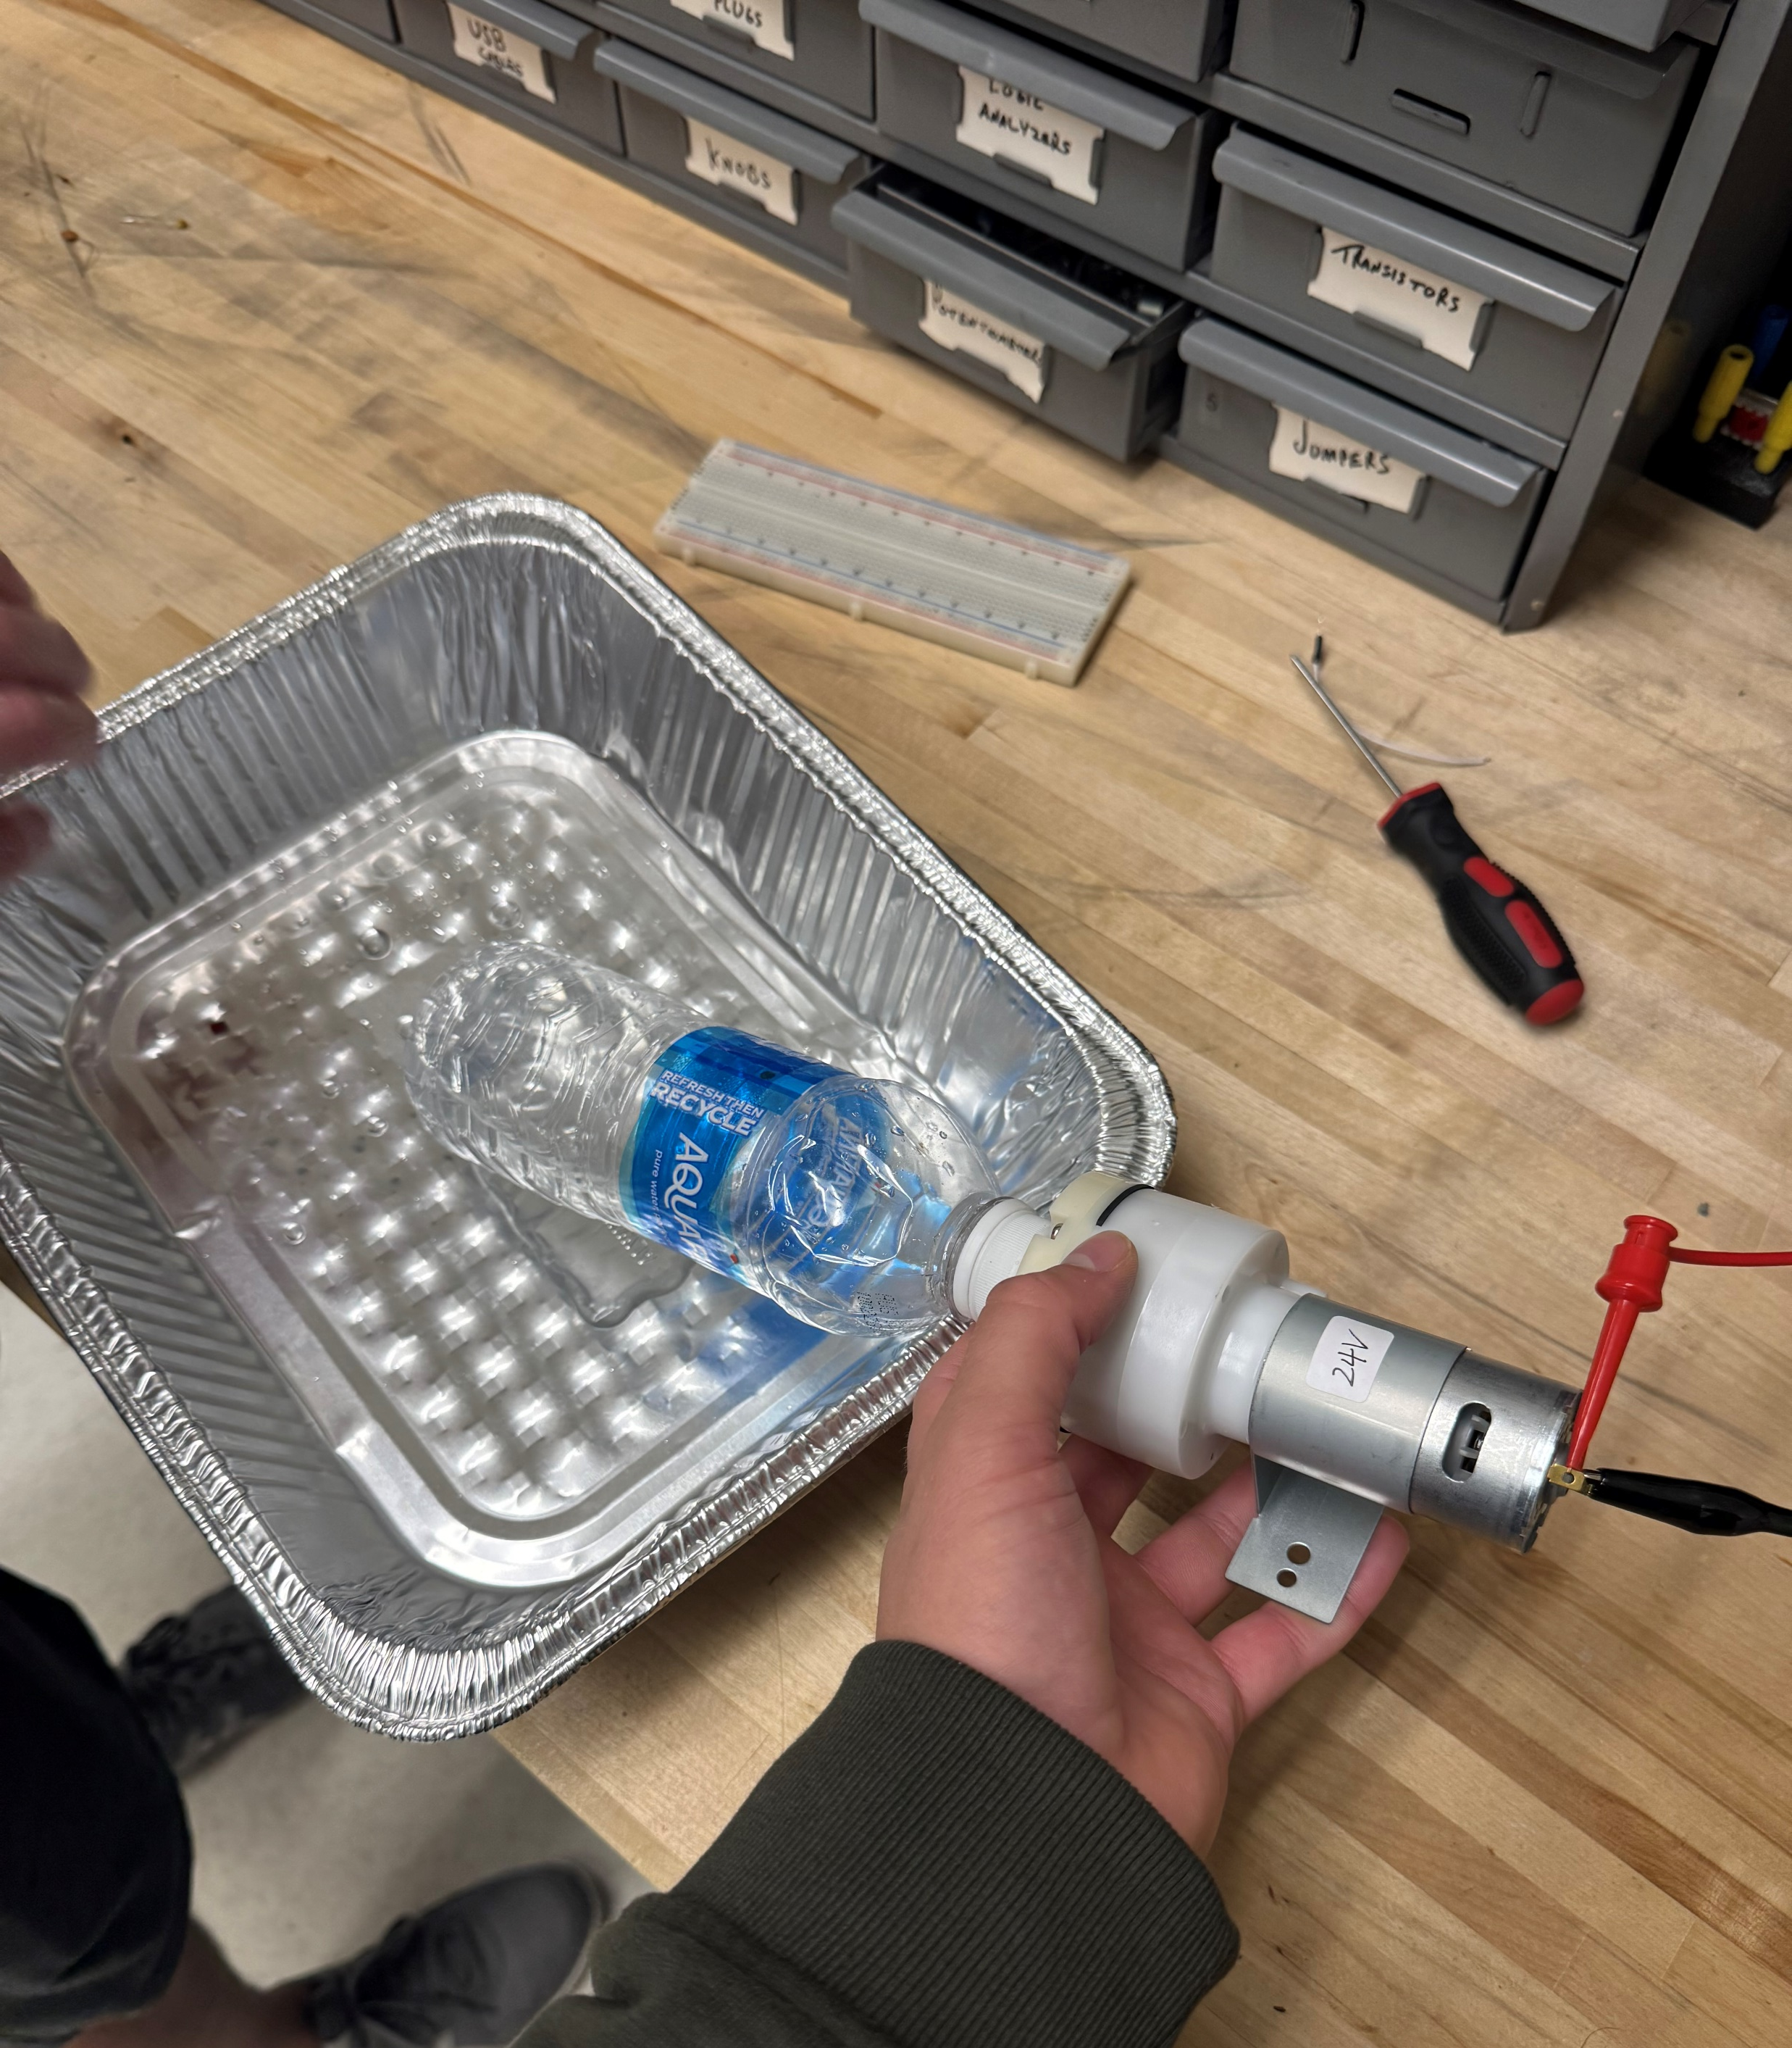
Summary
Functional UI
Automatic pumping and pouring of drinks

Slide 7
References

Slide 8

Conclusion
Thank you!!
Questions?

